Slide 1
Initial Phase of Medical Assessment

Slide 2
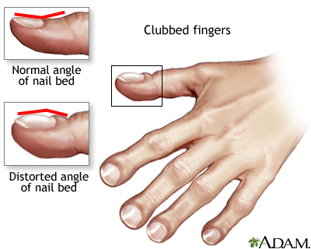
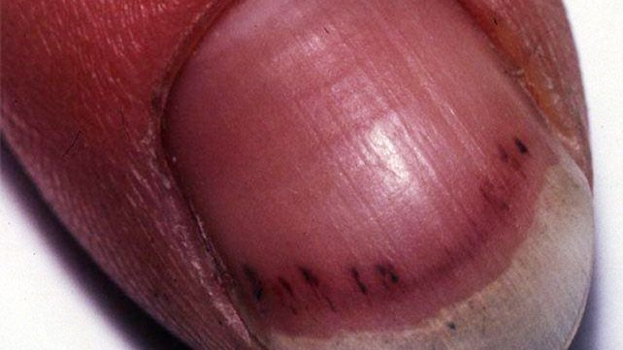
Nails
Examine fingers for clubbing
  Causes: Bronchiectasis
        Pulmonary Fibrosis
        Cyanotic congenital heart disease
        Infective endocarditis
        Inflammatory bowel disease
        Coeliac Disease
Splinter Haemorrhages
  Causes: Trauma
        Infective Endocarditis

Slide 3
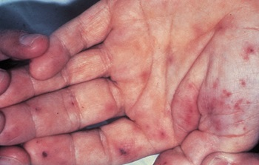
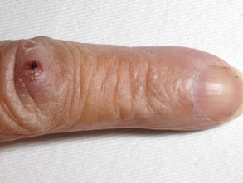
The Hand
Temperature Janeway Lesions
                Non-Tender haemorrhagic,
Sweating Mostly Palmar surfaces
                (Infective Endocarditis)
Grip Ostlers Nodes
                (Tender Red/Purple raised
Tremors lump)
                (Infective Endocarditis)
Colour/Cyanosis

Slide 4
Pulses
Radial Pulse
Presence
Rate
Rhythm
Compare Bilaterally
Collapsing Pulse

Slide 5
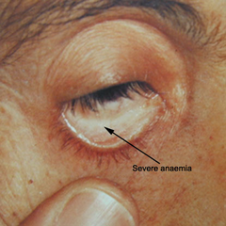
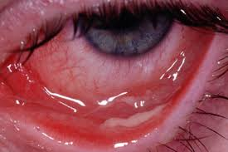
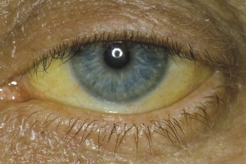
The Eye
Conjunctival Pallor
Infected Conjunctiva
Jaundice evident in sclera

Slide 6
Nose
Appearance of the nose
Discharge from nostrils
Evidence of congestion
Passageways

Slide 7
Mouth
Dentition
  Poor dentition increases risk of coronary heart disease
  (NAJAFIPOUR et al, 2013)
Tongue
  Smooth red tongue – Iron deficiency
  Furring ( Can be scraped off) – Can be normal with heavy smoker
  White patches (cannot be scraped off) - Fungal Yeast – Candida (Oral thrush)
Tongue tremors
  Anxiety
  Thyrotoxicosis (Excess of a thyroid hormone)
  Parkinsonism
Fasciculations
  Irregular rippling or twitching – Lower motor Neurone Disease
Evidence of Lesions
  Indicates oral hygiene
  Risk of infective endocarditis
  Possible indicator of oral cancers

Slide 8
Lymph Nodes
Ideally assessed from behind the patient
State name and location
A different PowerPoint

Slide 9
References
NAJAFIPOUR, H., MALEK MOHAMMADI, T., RAHIM, F., HAGHDOOST, A., SHADKAM, M., & AFSHARI, M. 2013. Association of Oral Health and Cardiovascular Disease Risk Factors “Results from a Community Based Study on 5900 Adult Subjects.” ISRN Cardiology, 2013, 782126. http://doi.org/10.1155/2013/782126

